Slide 1

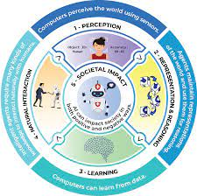




Artificial Intelligence for GA
Week 1
Standard:
EQ/LG:
Daily Assignments: Complete ALL the following assignments in order AND submit as instructed. Module 1.2 (A): Robot or Not Slides, Robot or Not Worksheet Module 1.2 (B): Autonomous Robots Slides , Autonomous Robots Worksheet | 3. Module 1.3: Anatomy of a Self-Driving Car , Self Driving Car Worksheet 4. Module 1.3: Anatomy of a Self-Driving Car Continued (part 2) | Accelerated Assignment: Kahoot (coming soon) Blooket Additional Resources:
Developed for the AI4GA (Artificial Intelligence for Georgia) project funded by National Science Foundation awards DRL-2049029 and DRL-2048502. This work is licensed under the Creative Commons. Attribution-NonComercial-ShareAlike 4.0 International License. https://creativecommons.org/licenses/by-nc-sa/4.0/

Slide 2

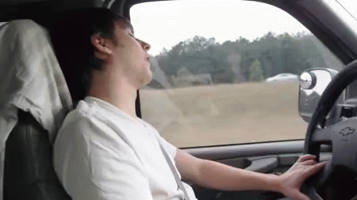
Artificial Intelligence for GA
Week 2
Standard:
EQ/LG:
Daily Assignments: Module 1.4: Module 1.4: Perception (Scratch) Module 1.4: Module 1.4: Perception (Scratch) Scratch continued with Gallery Walk) Module 1.5: Module 1.5: Route Finding, (AJ) , Module 1.5 Route Finding: Try it yourself | 4. Module 1.6: Module 1.6: Case Study on Self-Driving Cars , Activities and Questions Embedded in Slides 5. Review/ Game/Test or Mini-Project Review/Test Mini-Project Choice Board List of Possible Mini-Projects | Accelerated Assignment: Module 1.4: Edge Detection Face Demo Activity Guide (coming soon) Module 1.4: Face Mesh using Scroobly If you have longer class periods, consider doing more than one of the mini-projects, or both the Review/Test and a Mini-Project. Additional Resources: Module 1.6 - Shared Deep Dive: Cars and AI Driver Assistance Module 1.6 - Shared Deep Dive: Businesses, robots, and autonomous vehicles

